Slide 1


Introduction to GOODWILL Medicare
At Goodwill Medicare, we focus on personalized care for every patient, using the latest technology to ensure top-quality treatment. Our blend of compassion and advanced health systems helps us improve services for everyone's health and happiness.

Slide 2
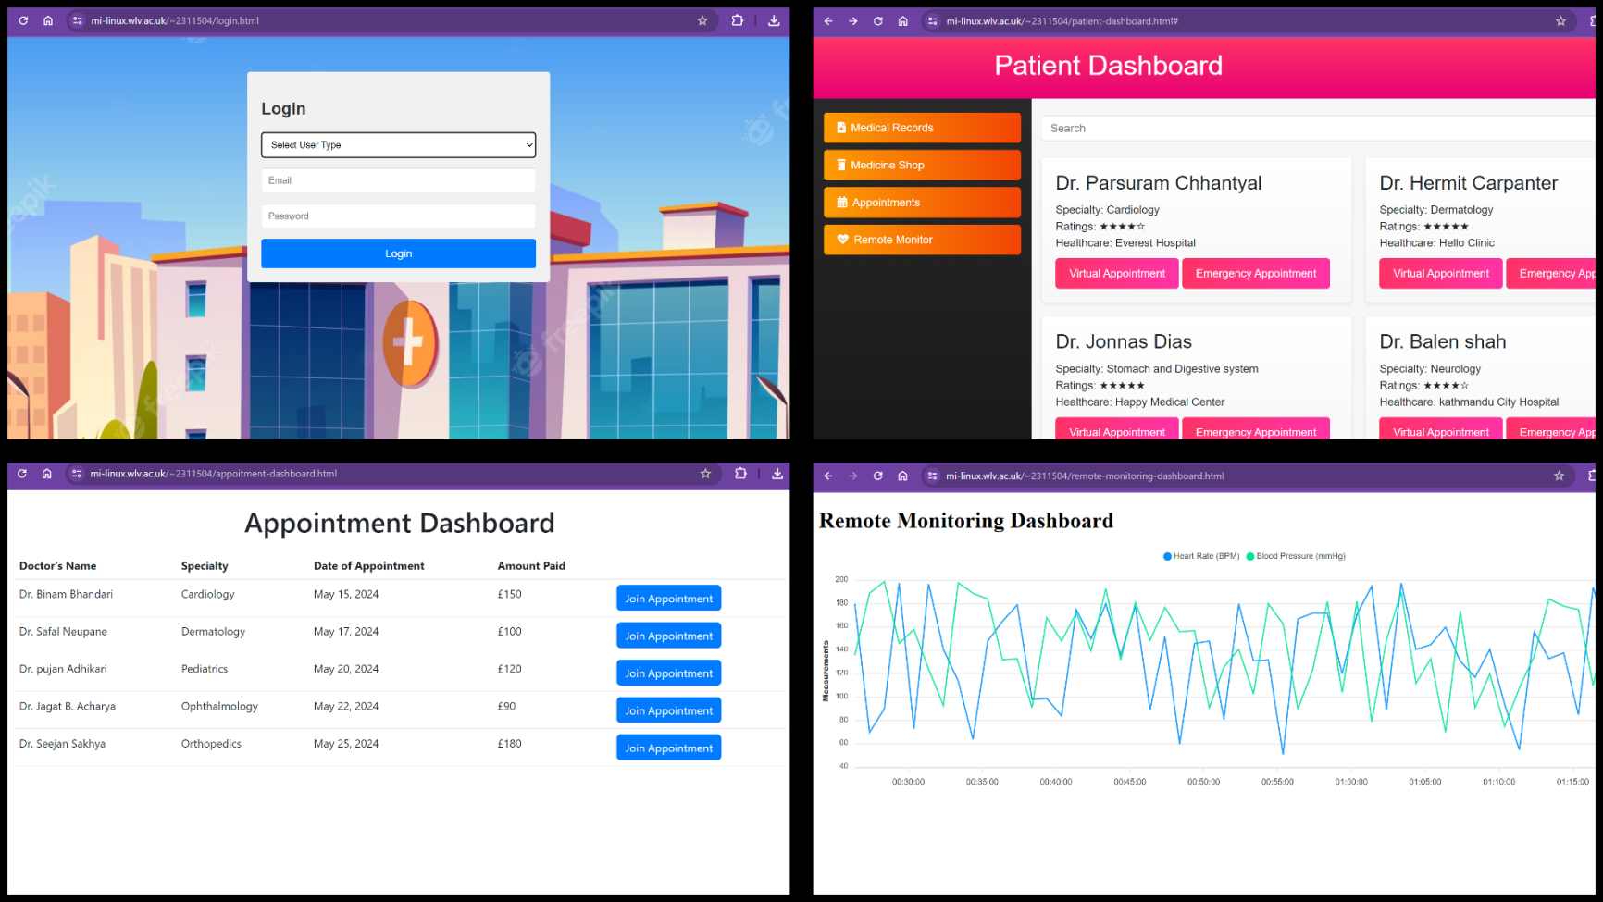
Project Objective
Our main goal is to create a user-friendly website for better access to Medicare services, making it simple for patients, staff, and health professionals. It's easy to sign up, schedule appointments, and purchase medicine. Also, we have a cool feature where the system automatically updates heart rate and blood pressure readings every five minutes for real-time monitoring of registered patients.

Slide 3
Technical Specifications
HTML and CSS, Java Scripts and were key programming languages in the development process. Git-hub was used for the collaboration.
The application has been hosted on the MI-Linux server.

Slide 4
Conclusion
Our latest Medicare website is designed to make managing health-related tasks effortless for users and administrators. With its user-friendly interface and real-time health monitoring features, website navigation is easy to use. What sets it apart is its continuous improvement mechanism, fueled by valuable user feedback, ensuring that the platform remains responsive to evolving needs and preferences. By embracing this solution, clients can expect not only streamlined processes but also long-term satisfaction as the website adapts and grows alongside their requirements.

